Slide 1


Biological & visual data mining for Predicting Cardiovascular Disease by machine learning algorithms

Slide 2

Table of contents
Problem statement
Literature survey
Motivation
Methodologies & algorithms
Experiment
Results
Conclusion
Future dimensions

Slide 3
PROBLEM STATEMENT & motivation
PROBLEM STATEMENT
MOTIVATION
Given the clinical parameters about the patients, can we predict whether or not they have heart disease?
Heart disease or cardiovascular disease is one of the biggest reason of death across the globe. As it is a cause of 35% of total death worldwide.
So, if somehow we manage to find the risk of someone having a heart disease beforehand then it would be helpful
Notes:
18 attributes are used including 14 parameters and 4 parameters of family history.
Heart Disease prognosis Using Machine Learning Classification -Ezaz Ahmed
2021
compared the accuracies by applying rule to the individual results of different architectures
Prediction of Cardiovascular Disease Using Machine learning Algorithms - Santhosh Kumar D
2019
Used HRFLM approach by combining the characteristics of linear method and random forest
Effective Heart Disease Prediction Using Hybrid Machine Learning -Santhilkumar Mohan
2018
Prediction system for heart disease using Naive Bayes-Uma Dulhare
Used particle swarm optimization technique to select the most optimum features which yield remarkable results

Slide 4
Literature Survey
These papers investigate the state of the art of various clinical decision support systems for heart disease prediction, proposed by various researchers using machine learning techniques.
YEAR | FINDINGS | TITLE & AUTHOR
2021 | Machine learning-based identification of patients with a cardiovascular defect -naboula louridi | Used MICE model to deal with the missing value during the pre-processing stage.
2021 | Heart Disease prognosis Using Machine Learning Classification -Ezaz Ahmed | 18 attributes are used including 14 parameters and 4 parameters of family history.
2021 | Prediction of Cardiovascular Disease Using Machine learning Algorithms - Santhosh Kumar D | compared the accuracies by applying rule to the individual results of different architectures
2019 | Effective Heart Disease Prediction Using Hybrid Machine Learning -Santhilkumar Mohan | Used HRFLM approach by combining the characteristics of linear method and random forest
2018 | Prediction system for heart disease using Naive Bayes-Uma Dulhare | Used particle swarm optimization technique to select the most optimum features which yield remarkable results
Notes:
Attributes that are taken:
• Age.
• Sex.
• Chest Pain type (CP).
• Trestbps (on admission to the hospital, resting blood pressure in mm Hg.).
• Cholesterol.
• Restecg (resting electrocardiographic results: assesses the heart’s activity.).
• Thalach (attained maximum heart rate).
• Exang (Angina caused by exercise is a common complaint of cardiac patients,
particularly when exercising in the cold).
• Oldpeak (Exercise-induced ST depression compared to rest).
• Slope (the curve of the ST segment of the peak activity).
• Ca (flourosopy coloration of a lot of major vessels (0-3)).
• Thal (normal, fixed defect, reversable defect).
• Num (the predicted attribute).
Dataset
Screenshot

Slide 5
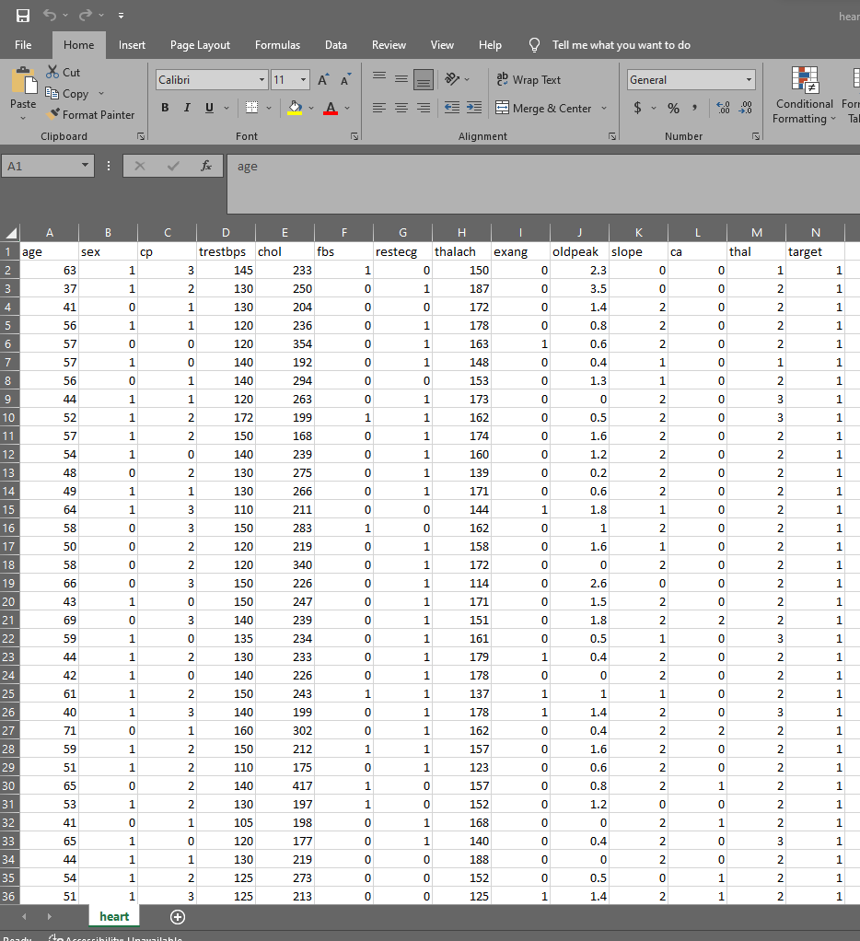
DATASET
Notes:
Dataset screenshot

Slide 6
Attributes that are taken:
Age.
Sex.
Chest Pain type (CP).
Trestbps (on admission to the hospital, resting blood pressure in mm Hg.).
Cholesterol.
Restecg (resting electrocardiographic results: assesses the heart’s activity.).
Thalach (attained maximum heart rate).
Exang (Angina caused by exercise is a common complaint of cardiac patients,
particularly when exercising in the cold).
Oldpeak (Exercise-induced ST depression compared to rest).
Slope (the curve of the ST segment of the peak activity).
Ca (flourosopy coloration of a lot of major vessels (0-3)).
Thal (normal, fixed defect, reversable defect).
Num (the predicted attribute).
Notes:
Attributes that are taken:
• Age.
• Sex.
• Chest Pain type (CP).
• Trestbps (on admission to the hospital, resting blood pressure in mm Hg.).
• Cholesterol.
• Restecg (resting electrocardiographic results: assesses the heart’s activity.).
• Thalach (attained maximum heart rate).
• Exang (Angina caused by exercise is a common complaint of cardiac patients,
particularly when exercising in the cold).
• Oldpeak (Exercise-induced ST depression compared to rest).
• Slope (the curve of the ST segment of the peak activity).
• Ca (flourosopy coloration of a lot of major vessels (0-3)).
• Thal (normal, fixed defect, reversable defect).
• Num (the predicted attribute).

Slide 7
APPROACH METHODOLOGY MACHINE LEARNING ALGORITHMS
Naive bayes(NB)
Random Forest(RF)
Adaptive boosting(Adaboost).
Notes:
APPROACH METHODOLOGY
MACHINE LEARNING ALGORITHMS:
Naive bayes(NB)
Random Forest(RF)
Adaptive boosting(Adaboost).

Slide 8
RANDOM FOREST ALGORITHM
The missing values will be handled by the random forest classifier, which will maintain the detection rate of a large portion of the data.
The Random Forest is made in two stages: the first is to join N choice trees to make the arbitrary timberland, and second is to make any expectations for each tree created in principal stage.
Notes:
RANDOM FOREST ALGORITHM
The missing values will be handled by the random forest classifier, which will maintain the detection rate of a large portion of the data.
The Random Forest is made in two stages: the first is to join N choice trees to make the arbitrary timberland, and second is to make any expectations for each tree created in principal stage.

Slide 9
NAVIES BAYES ALGORITHM
The Bayes Theorem states that when determining a conditional probability, the final output is determined by each conditional probability.
The classifier make the susoicion of strong, or guileless, liberation between information point credits.
Naive Bayes classifiers have exceptionally good performance on the grounds that they require a bunch of boundaries that is relative to the quantity of characteristics in a learning issue.
Notes:
NAVIES BAYES ALGORITHM
The Bayes Theorem states that when determining a conditional probability, the final output is determined by each conditional probability.
The classifier make the susoicion of strong, or guileless, liberation between information point credits.
Naive Bayes classifiers have exceptionally good performance on the grounds that they require a bunch of boundaries that is relative to the quantity of characteristics in a learning issue.

Slide 10
ADAPTIVE BOOSTING ALGORITHM
Adaptive Boosting is a technique in machine learning used as an Ensemble Method.
The most common algorithm used with AdaBoost is decision trees with one level that means with Decision trees with only 1 split.
The weights are re-assigned to each instance, with higher weights assigned to incorrectly classified instances.
Notes:
ADAPTIVE BOOSTING ALGORITHM
Adaptive Boosting is a technique in machine learning used as an Ensemble Method.
The most common algorithm used with AdaBoost is decision trees with one level that means with Decision trees with only 1 split.
The weights are re-assigned to each instance, with higher weights assigned to incorrectly classified instances.

Slide 11
INITIAL RESULTS
Algorithms | Accuracy
Support Vector Machine | 84.2%
Ada-Boost | 84.2%
Random Forest classifier | 82.8%
Logistic Regression classifier | 81.5%
Decision Tree classifier | 78.9%
By far we have checked the correlation between the features and correlation of the target variable
Notes:
INITIAL RESULTS
By far we have checked the correlation between the features and correlation of the target variable
CODE

Slide 12
Conclusion and Future work
The prediction exhibition of each technique and apply the proposed system for the area it required, The accuracy achieved for Naive Bayes is 85.25%, Random Forest showed 90.16% and AdaBoost displayed 90.16 %.
We desire to apply AI to exhibit a connection between cardiovascular illness and air quality.
Notes:
Conclusion and Future work
The prediction exhibition of each technique and apply the proposed system for the area it required, The accuracy achieved for Naive Bayes is 85.25%, Random Forest showed 90.16% and AdaBoost displayed 90.16 %.
We desire to apply AI to exhibit a connection between cardiovascular illness and air quality.

Slide 13
ANY QUESTIONS ?
THANK YOU!

